Slide 1
Binding Redux
and Flow

Slide 2



What you will learn

Slide 3

State change in React
State change:
• Triggers the re-rendering of DOM in React
• Involves transfer of data and long chain of props
• Requires state management done by Redux
• Managed in React Redux using a sing[e Store and
Reducers
• Is easier in Redux

Slide 4
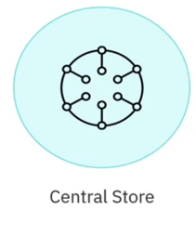

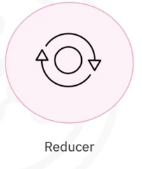

Redux building blocks

Slide 5
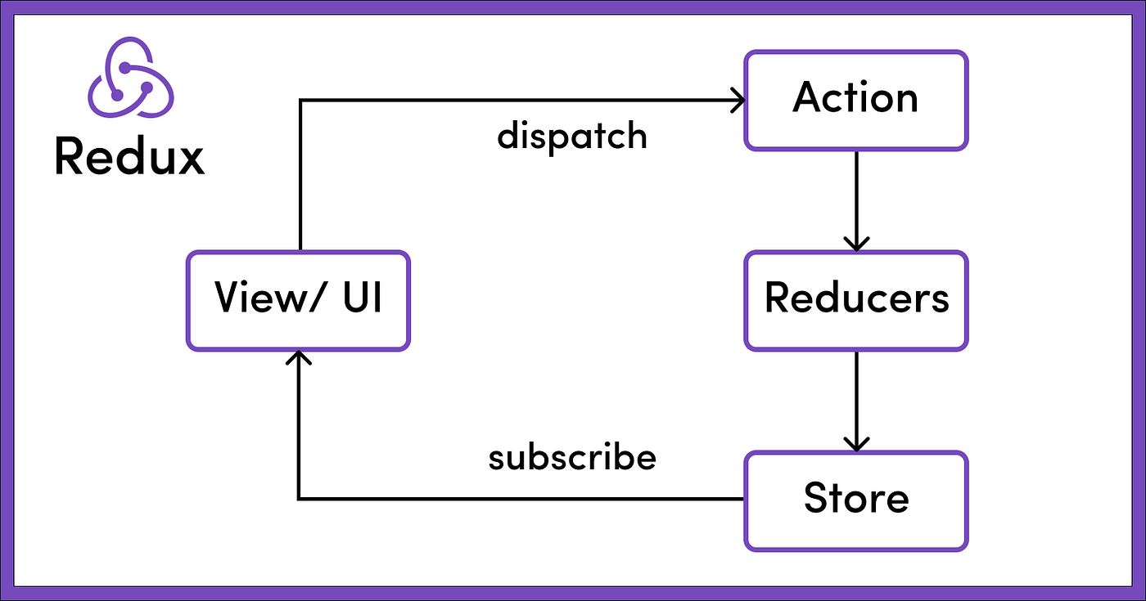
Data Flow

Slide 6




Why one way data flow

Slide 7



Advantages of data flow in Redux

Slide 8
Recap
In this video, you Learned that:
• When the state of a component changes, React responds by
triggering the re-rendering of the DOM.
• The Redux elements that are involved in updating of the
component properties are: Central Store, Actions, Reducer, and
subscription.
• The data flow in a React-Redux application is unidirectional.
• It is easier to manage the state when actions performed on the
UI are separated from the changing of the state.

